Slide 1

Team Details
Team Name: RUGVED
Team Members’ Name: Abhigyan, Arnav, Harshal,Siddharth
College Name: Manipal Institute of Technology

Slide 2
Problem Details
Problem Statement:
How does inclusion of AI in agriculture give rise to new sustainable and efficient models ?
Problem Description:
unforeseen changes in weather , inaccurate soil information and cultivation of unsuitable crop and improper detection of plant health are few of the most common nightmares farmers face.

Slide 3
Artificial Intelligence is one of the fastest growing sector , while agriculture is the oldest yet the slowest growing sector in modern times. A fancy fusion of these two sectors would ease life of many.
To make the lives of our farmers easier, we have devised few solutions to the above problems:
We have developed a model which predicts the type of soil , with just a picture of it.
We have developed an algorithm that can predict the type of crop that is best suited for the soil based on the required parameters.
We have reduced the ambiguity with health of the plant by developing an algorithm which predicts if the plant is healthy or unhealthy.
To top it off we have created a user-friendly app which even a commoner can use and access all the above-mentioned features. .

Slide 4
Model Description:
Soil Classification:
Based on our research we have found the major soils present in India and developed an
algorithm to classify the soil based on the image input.
Major soil classes the algorithm can predict:
"Black Soil“
"Cinder Soil“
"Laterite Soil“
"Peat Soil“
"Yellow Soil"
.
Accuracy: 94.8%
Loss: 12.6%

Slide 5
Model Description:
Crop Recommendation:
We have developed an algorithm that can predict the type of
crop that is best suited based on the soil based on-
1. Nitrogen, Potassium and Phosphorus
2. Temperature
3. Humidity
4. Rainfall
Accuracy: 96.18%

Slide 6
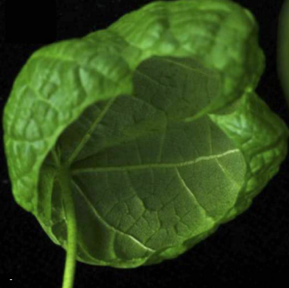
Model Description:
Plant Status:
By observing the photo of a leaf, the algorithm developed by us can detect whether a
plant is healthy or not and what type of disease does it have.
Accuracy: 97.4%
Loss: 12.2%
Leaf with curl virus

Slide 7
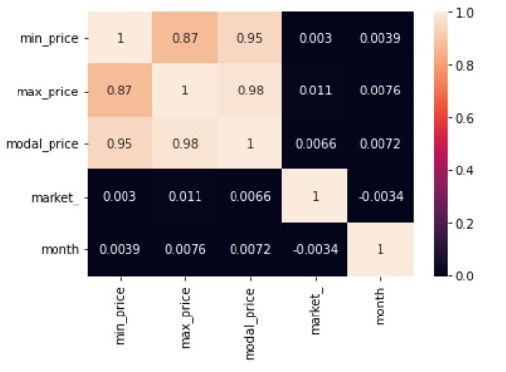
Model Description:
Price prediction :
The algorithm we developed can help in predicting the future prices of the plant or crop that is given as an input.
Accuracy – 99.4%

Slide 8
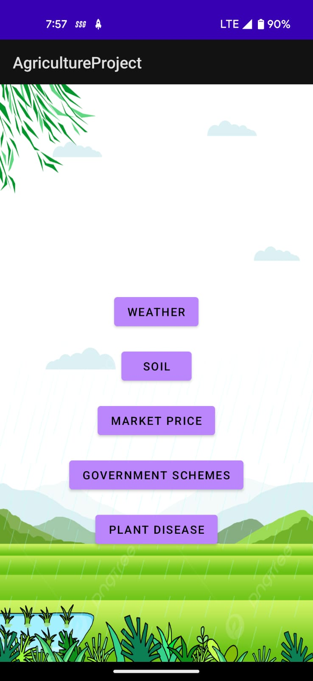
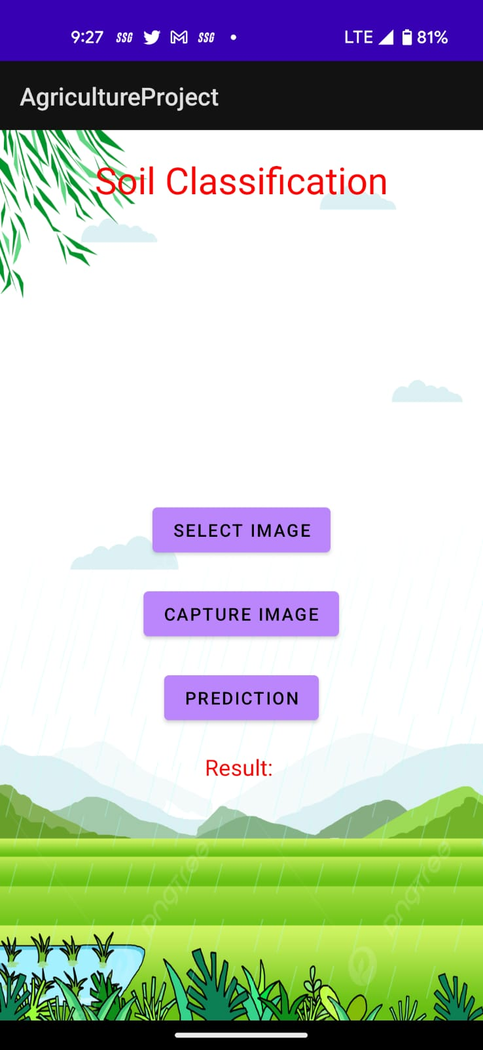
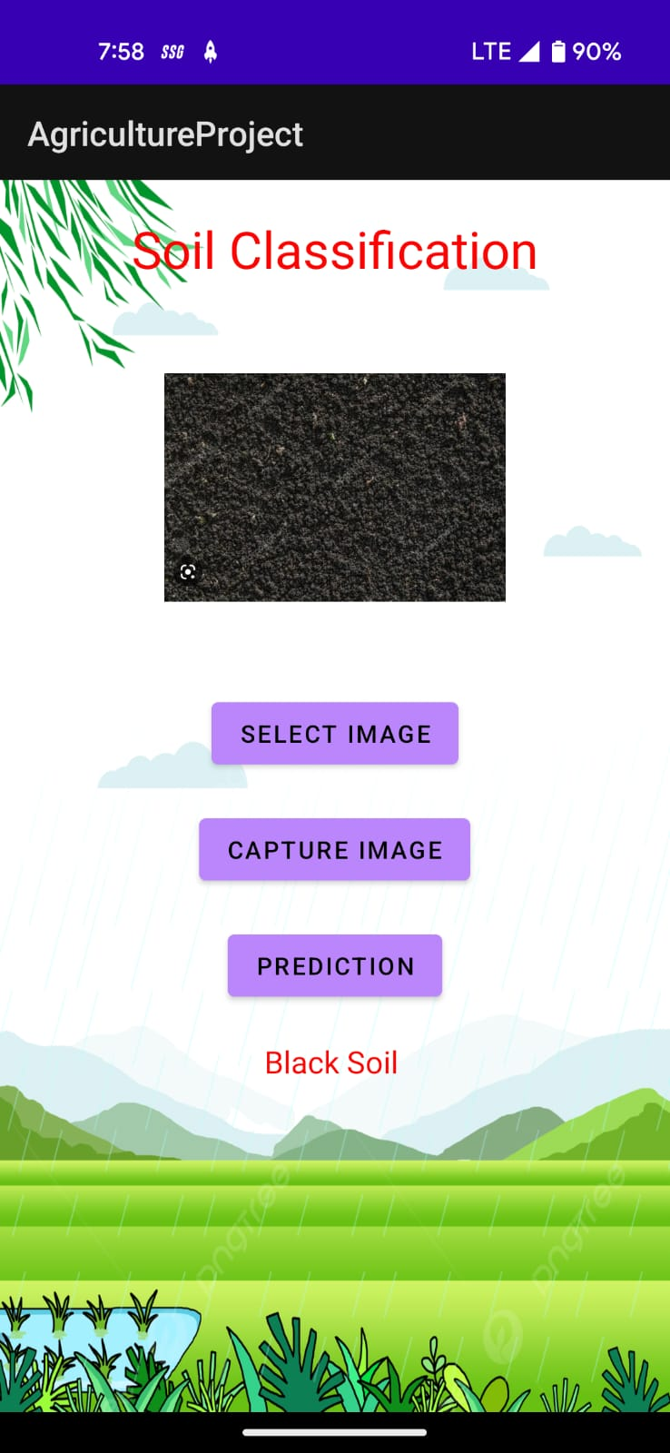
Android studio to the rescue!!
Prototype of the app
Load image

Slide 9
Dataset (Resources):
https://www.kaggle.com/datasets/atharvaingle/crop-recommendation-dataset
https://www.kaggle.com/datasets/mansijain14/soil-classification-dataset
https://www.kaggle.com/datasets/seroshkarim/cotton-leaf-disease-dataset
https://www.kaggle.com/datasets/syedjaferk/agriculture-commodity-data-2019
Opencv
Machine learning (regression models)
Deep learning(CNN classification)
Basic math libraries [pandas, numpy, matplotlib]
Android studio using java
Tensorflow using keras
Sklearn library

Slide 10
Something about ourself
RUGVED is a multi disciplinary student project located at MIT , Manipal.
We are sophmore year students from MIT aming to be a better version of ourself and be a part of a cherished community that helps the backbone of our nation.

